Slide 1
Simulation of Travelling Salesman Problem through Simulated Annealing and Genetic Algorithm
By Hai Ngoc Nguyen, Jaba Dam Nay, Jivitesh Sharma, Aditya Patil, Amol Prakash, Aryamaan Jena, Gautam Sadarangani, Kanishq Reddy and Shivit Dhamija

Slide 2
Problem Background
The travelling salesman problem is an optimization problem.
It has a wide range of applications to fields like computer wiring, vehicle routing, combinatorial data analysis, etc.
The objective of the travelling salesman problem is to find an optimum tour route wherein each of n specified cities (or places) must be travelled to, visiting each city exactly once and returning to the initial point
Common simulation techniques used to solve the problem include genetic algorithms and simulated annealing
Simulated Annealing is a Monte-Carlo maximization or minimization technique
Genetic Algorithm adapts techniques from genetics in biology

Slide 3
Problem Statement
Drawing a comparative between the performance of genetic algorithm and simulated annealing method in solving the travelling salesman problem
Genetic algorithm works better for this problem but there is a trade-off with run-time
Simulated Annealing being a bit faster than Genetic algorithm for this travelling salesman problem

Slide 4
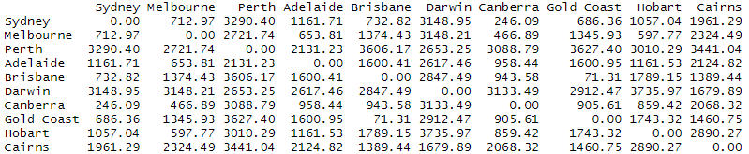
Data Collection
To make a valid comparison, we use the same distance matrix for both the algorithms. The data was generated using inbuilt R function “dist”, which calculates the distance of each pair of cities for 10 cities in Australia given a list of city names.

Slide 5

Parameters
Genetic Algorithm | Simulated Annealing
Population | Temperature
Mutation rate | Cooling rate
Crossover rate | Absolute temperature

Slide 6
Monitoring Runtime
While the main purpose is to produce the optimized route for the salesman to travel, it is of utmost importance to take into consideration the runtime of each algorithm.
Comparing runtime of two algorithms is a tough task due to the difficulties in the execution of the code in different compilers and machines with potential difference in configurations.
An example of the output when calculating runtime:

Slide 7
Solution Approach: Simulated Annealing
Calculate distance by using a distance function of a sequence
Defining the swap() function to interchange 2 nodes in a given sequence (Ex: 1,2,3,4 -> 1,3,2,4) to create sequence 2
Calculating ∆Distance and defining the acceptance probability
Accepted sequence moves on and the process is repeated, else if sequence is not accepted new sequence is generated

Slide 8
Solution Approach: Genetic Algorithm
Importing pre-existing GA library
Creating a tourLength function to calculate the total distance of the sequence
Defining tspFitness function
Implementing GA function on distance matrix and printing out summary(GA) to give the sequence
Calculating total distance of the particular sequence using tourLength() function
Monitoring the runtime simultaneously

Slide 9
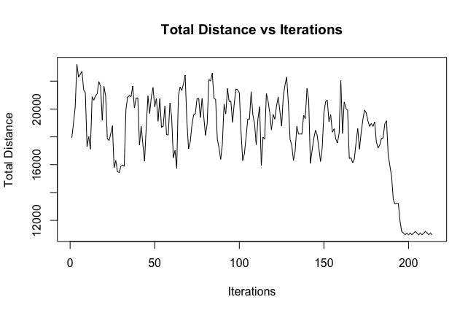
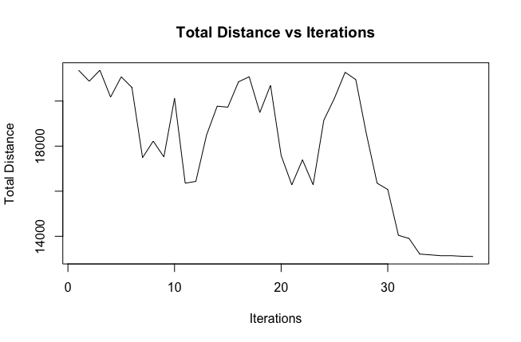
Results for Simulated Annealing
Cooling rate of 10%:
Cooling rate of 50%:

Slide 10
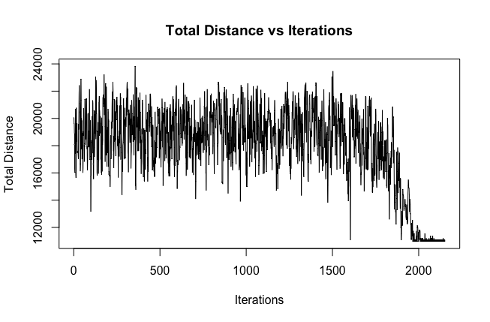
Results for Simulated Annealing
Cooling rate of 1%:

Slide 11
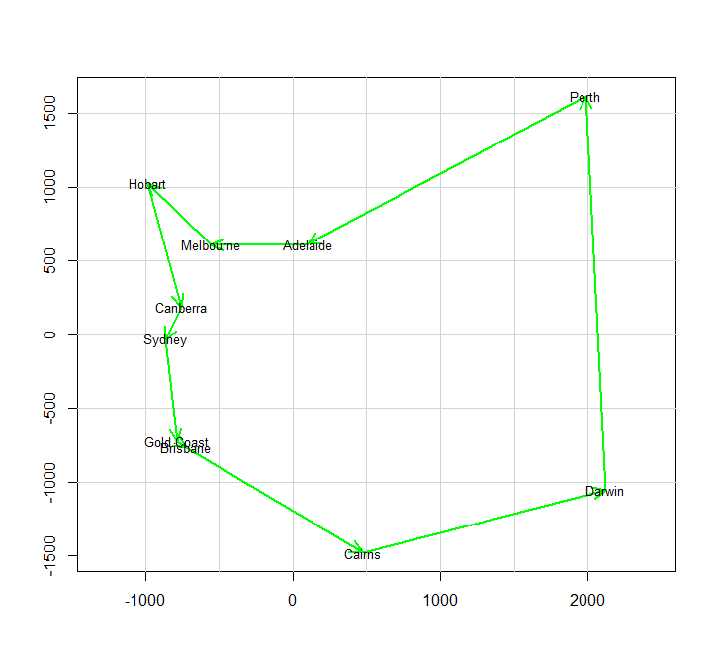
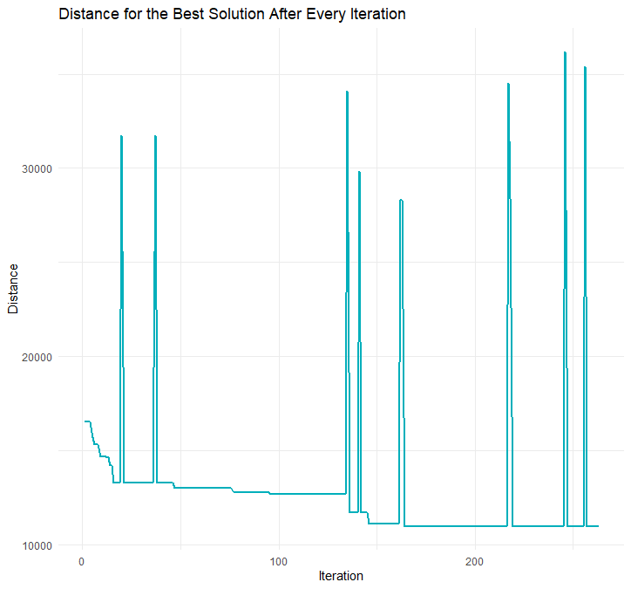
Results for Genetic Algorithm
Paths through all 10 cities:
Distance for the best solutions:

Slide 12
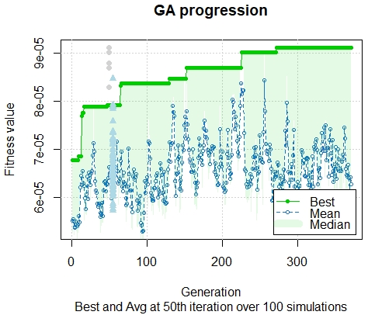
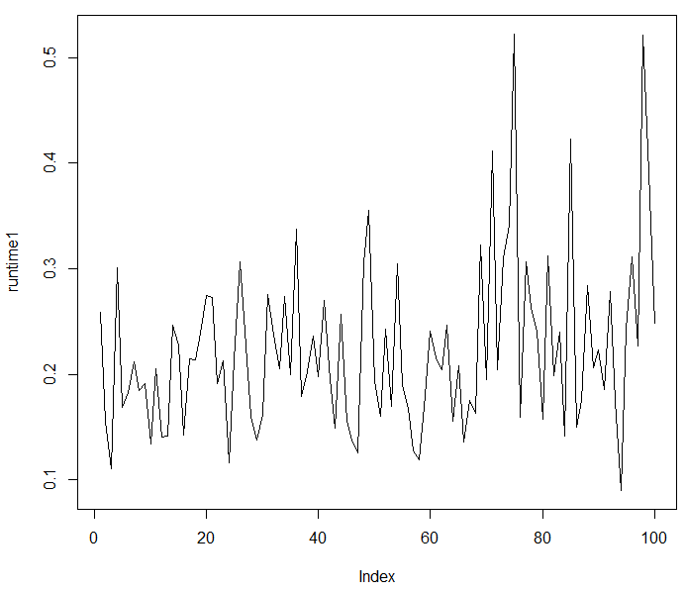
Results for Genetic Algorithm
GA progression over 100 simulations:
Runtime difference of 100 simulations:

Slide 13
Result for Genetic Algorithm
Animation of the best path using GA:

Slide 14
Conclusions
Both Genetic Algorithm and Simulated annealing provide ideal solution if right parameters are set
Both algorithms give the same total distance for this problem
Can be used to solve practical optimization problems like warehousing distribution problem

